Slide 1


Increase Accounting Productivity and Quality through Expert Automation
Chapter: Bank Reconciliation

Slide 2
Agenda
Section
Page
Background
1
2
Uplift Experience
2
7
Demo
3
10
SFP Offer
4
24
Questions and Answers
5
27

Slide 3
Background
1
Hinson Chan, CPA
Executive Officer
School Finance Productivity
hchan@mindspheretg.com

Slide 4
SFP Productivity Beliefs
Accounting requires a lot of professional judgement to resolve issues and handle unique scenario specified to our customers. Accounting also has many repetitive processes that we will do over and over again daily, monthly or annually.
We believe that we can:
  Dissect key repetitive processes based on sound accounting principles and practices
  Use automation to extract data from Accounting system(s)
  Use automation to perform rule-based procedures for valid business scenario as if they are done manually by accounting experts
  Use automation to report transaction exceptions for user resolutions
  Use automation to report process statuses for management review and approval
Imagine how your work would change if you just hire a seasoned assistance who does what you want, works fast, works accurately, and does not go to sleep.
Imagine how your work would change if you have seasoned accounting profession who can discuss issues with you and help you keep up with accounting standard changes.
Your time will be freed up to manage exceptions, anticipate change, determine improvement opportunities, and cover more areas.
We should work smarter, not necessarily harder or longer.
We are committed on our Productivity Beliefs !!!

Slide 5
Bank Reconciliation
The focus of this presentation is on the Bank Reconciliation process.
The following are other SFP productivity application:
  Financial Reporting (Charter Schools, ISD coming soon)
  Payment Authorization & Purchase Requesting
  Payroll Reconciliation
  Work Force Management & Field Trip Ordering with time clock, payroll and leave management
  Charter FIRST - Provide projected scores for proactive management
  (soliciting early adopters)
  Accounting & Finance checkup (coming soon)

Slide 6
Bank Reconciliation
What | An essential internal control to reconcile bank cash and book cash transactions
Why | Safeguarding of assets - Provide assurance regarding prevention or timely detection of unauthorized use of the organization’s assets Errors or Omissions - Ensure both bank and book cash transactions are valid, complete and recorded accurately in a timely manner Efficiency - Identify internal accounting procedures that need attention Cash flow - Know how much cash you really have available Fraud and Prevent Loss - Detect unusual transactions for possible frauds Generally, if an error hits your account, you have 60 days after your statement is created to report errors. If there were multiple problem transactions from the same person, you have 30 days from the statement date to find the error and inform the bank.
When | Ongoing with a monthly check point
Who | Segregation of Duties: Staff who performs bank reconciliations should not record transactions in the same accounting period or have custody of cash. Example: Your employee stole some checks payable to the business and forged the endorsement. Bank cannot protect you from the actions of your employees. It is your responsibility to have separation of duties to catch the fraud.

Slide 7
Bank Reconciliation
How | 1 | Collect and organize all supporting transactions, including carryovers Need data for all puzzle pieces to perform process effectively and efficiently
 | 2 | Verify book integrity. Reconcile general ledger cash transactions are properly supported by subsidiary cash ledgers (i.e., disbursement, receipts, payroll) Example: void payroll checks not posted to the general ledger
 | 3a | Reconcile (Indirect approach): Identify unreconciled transactions that explain the difference between the book and cash ending balance. Less accurate: Matched transactions may not be valid.
 | 3b | Reconcile (Direct approach): Match bank and book transactions based on valid business transaction scenario with documented audit trails. The remaining are unreconciled transactions. Preferred: Matched transactions are supported by valid reasons
 | 4 | Research, document and resolve unreconciled transactions with management approval. Follow up on unusual transactions such as deposits in transit over 4 days, old checks and void/return checks.
 | 5 | Prepare bank reconciliation reports for management approval.
 | 6 | When data changes, identify the changes and perform the above steps again
What happens if you only need to do step 4?

Slide 8
Uplift Experience
2
From Deborah Curry
Director of Accounting
Uplift Education
dcurry@uplifteducation.org

Slide 9
Uplift Challenges
Change accounting system to TEAMS
Staff turnovers during and after the implementation
Staff learning curve to use TEAMS
Staff learning curve to use DB Visualize and to understand TEAMS database tables, columns, views and relationships
Transactions did not follow sound accounting principals on coding and dates
Spent majority of time extracting, organizing cash transactions, unsure whether any were missed or duplicated
When cash ending balances changed due to transactions recorded to prior months, no exposure to determine the changed transactions and redo the bank reconciliation
Endless cycle of reconciliation, reacting to data uncertainties and changes

Slide 10

Uplift Actions
Provided TEAMS training to new accounting staff
Enhanced accounting procedures on cash transactions
Utilized the SFP Bank reconciliation application to
  Build automated data interfaces to bring in TEAMS data for journal entries, check details, receipt details and payroll details
  Configure reconciliation rules to perform auto-matching
  Within munities, rerun bank reconciliation repeatedly at any accounting periods to identify issues, determine adjustments and measure progress
Obtained strong SFP support to dissect relationships between bank and book cash transactions, provide improvement options, and resolve unreconciled cash transactions.
Now, we run bank reconciliations periodically within a month with near 100% reconciliation !!
We follow up on exceptions. Our focus shifts from data preparations and routine matching to managing an easily and clearly identify bank or book transactions not being recorded properly. We are proactively unreconciling transactions and determine root causes. We work smarter and happier on our progress.

Slide 11
Demo
3
SFP built the application with best reconciliation practices and supporting summary, detail and alert reports. If you have suggestions, SFP would love know to further enhance the application.

Slide 12
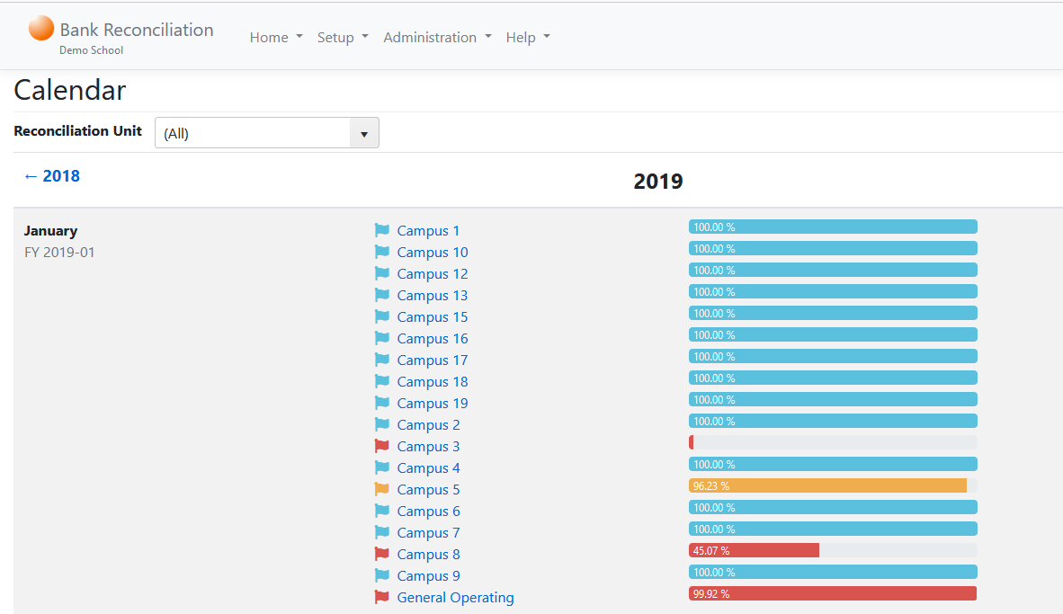
Bank Reconciliation - Demo
Calendar to show and mange progress by bank reconciliation unit and month

Slide 13
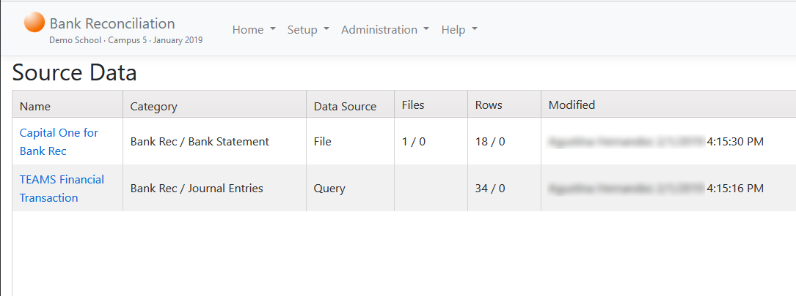
Bank Reconciliation - Demo
Source Data screen to
Allow users to import bank transactions
Define TEAMS database queries to extract book cash transactions

Slide 14
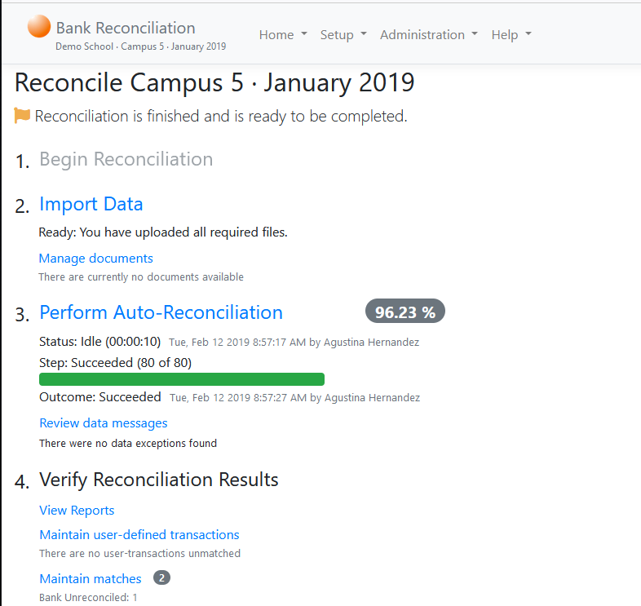
Bank Reconciliation - Demo
Main Reconciliation Menu, showing a step-by-step process
With minutes:
Extract and organize TEAMS cash transactions for journal entries, checks, receipts and payroll, void, ACHs, direct deposits, etc.
Carry over unreconciled transactions from the previous month
Perform pre-defined reconciliation rules as if you do it yourself manually
Organize results for reporting

Slide 15
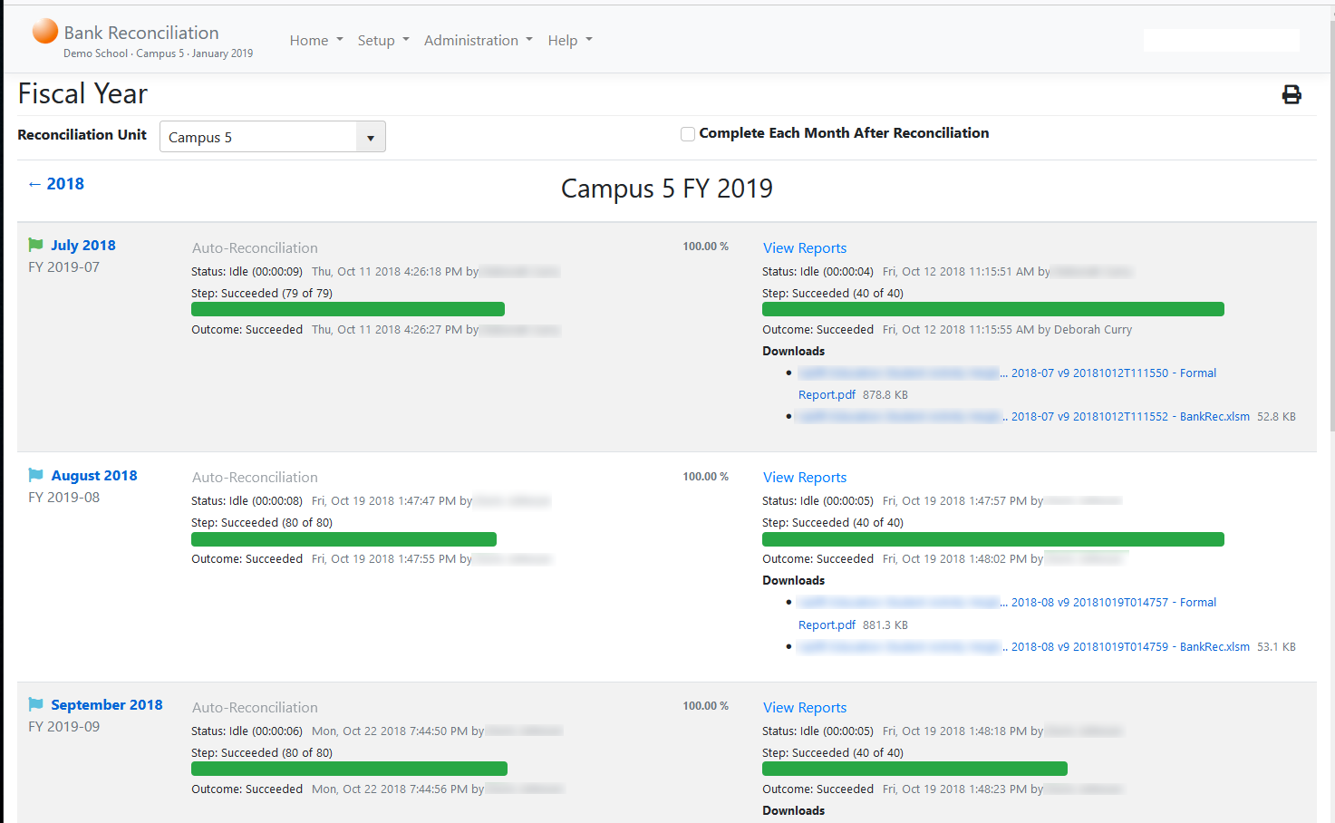
Bank Reconciliation - Demo
Run all accounting periods within a fiscal year with one-click

Slide 16
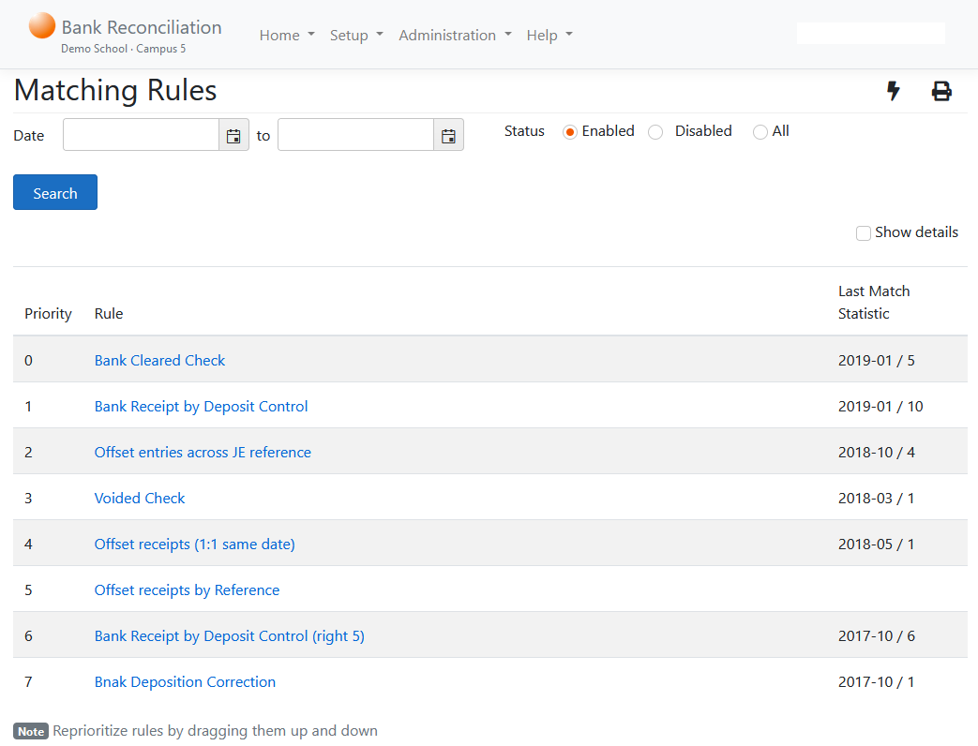
Bank Reconciliation - Demo
Pre-defined reconciliation rules, simulating what you or an expert will do to reconcile transactions based on valid business scenario
By defining the rules once, the application will act as your assistance to execute the rules in an accurate and efficient manner

Slide 17
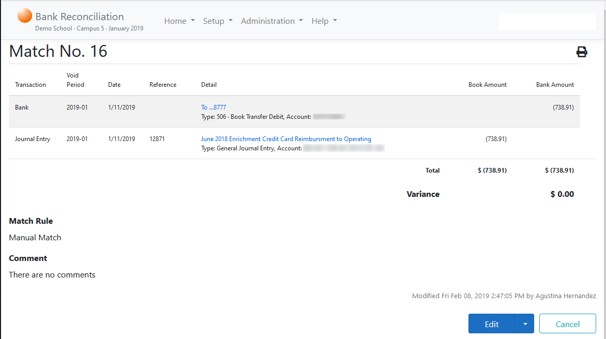
Bank Reconciliation - Demo
Manual match screen to allow users to perform manual matches for unique situations requiring user reviews

Slide 18
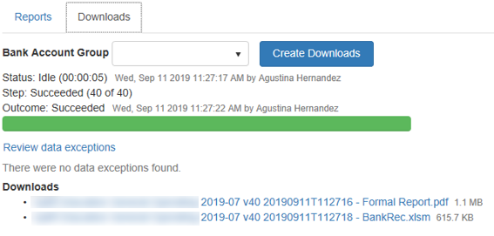
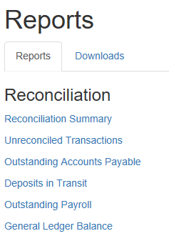
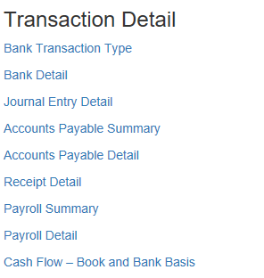
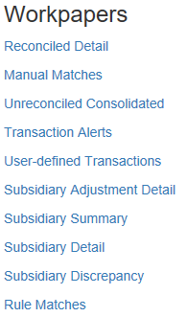
Bank Reconciliation - Demo
Report screen to provide:
Summary report
Detail transactions
Workpapers to show the reconciliation
Excel or PDF downloads

Slide 19
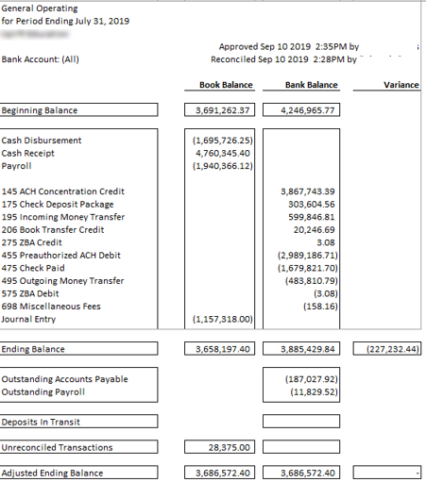
Bank Reconciliation - Demo
Bank Reconciliation Summary report showing:
Beginning Balances
Transaction Summary
Ending Balances
Outstanding Payable Checks
Deposits in Transit
Outstanding Payroll Checks
Unreconciled Bank Transactions
Unreconciled Book Transactions

Slide 20
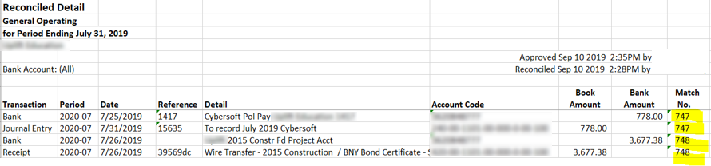
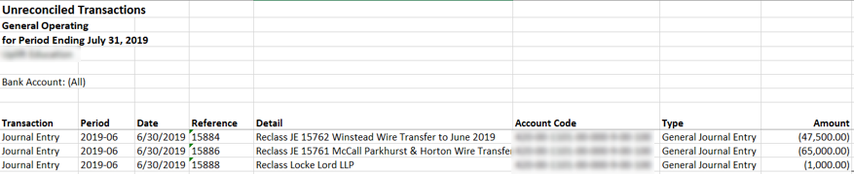
Bank Reconciliation - Demo
Reconciliation workpaper showing transactions are matched with a sequence control number.
Unreconciled transaction report showing transactions that require user attention

Slide 21
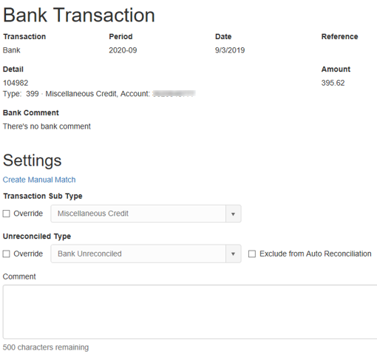
Bank Reconciliation - Demo
Transaction Detail screen to allow users to:
Reclassify transactions to different un-reconciled types
Provide user comments as documentation for future reconciliation

Slide 22
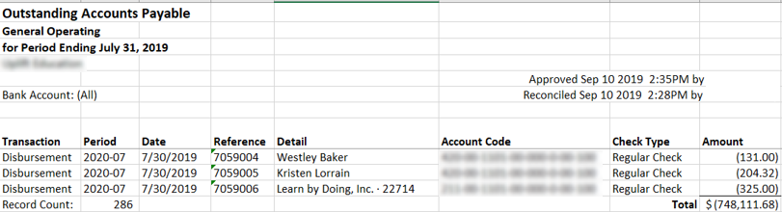
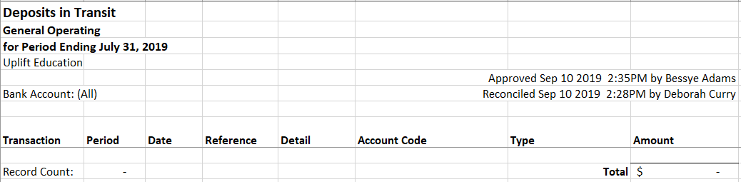
Bank Reconciliation - Demo
Outstanding Payable report
Deposits in Transit report

Slide 23
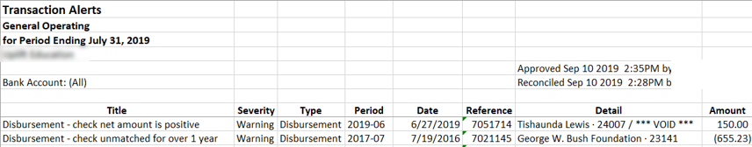
Bank Reconciliation - Demo
Transaction alert report showing abnormal transactions needing user review

Slide 24
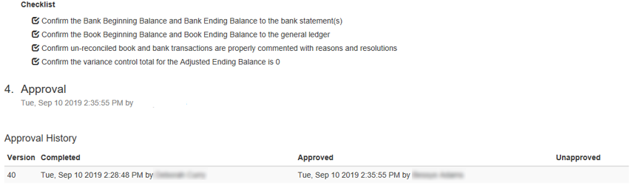
Bank Reconciliation - Demo
Management approval screen for authorized approvers, showing approval audit trails

Slide 25
SFP Offer
4

Slide 26

SFP Offers
SFP is confident that it can help improve the accuracy, efficiency and timeliness of your current bank reconciliation process
SFP offers a 3-month trial. If you do not see values, there will be no cost to you.
SFP has the brochure available to describe the Bank reconciliation application and the free trial
SFP wants to gain your trust on our productivity beliefs. SFP believes we can help improve productivity and efficiency on other productivity processes.
If you have questions or want to know more, please contact us for a demo.

Slide 27
About SFP
School Finance Productivity (SFP) is a division of Mindsphere Technology Group (MSTG)
SFP is lead by Paul King. Mr. King has served in the public education financial operations of public and non-profit entities in Texas since 1985, holding positions from Director of Finance to Assistant Superintendent for Business and Chief Financial Officer during his career.
SFP provides accounting and finance consulting services to many Texas Charter Schools. Currently, SFP servers as the CFO for four Texas Charter Schools.
SFP productivity tools are used in different ISDs and Charter Schools. Example: Leander ISD (since 2004), San Antonio ISD (since 2009) and Texan Can Academy (since 2008).
MSTG was formed in 2001 by Hinson Chan, CPA. Hinson has over thirty years of experience in accounting process management, auditing and business application development in the oil/gas, manufacturing, retails, airline and education industry.
MSTG focuses on developing accounting productivity applications in the Texas Education industry. It also provides consulting services for accounting data integration and analysis.

Slide 28
Questions and Answers
5

